Slide 1
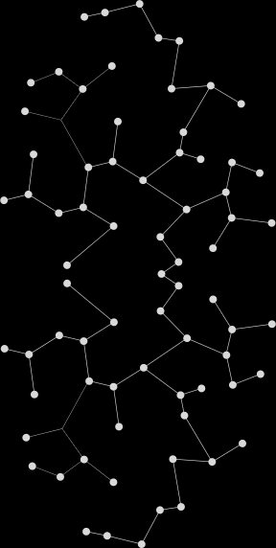
What are we going to discus today ?
Why are we moving into RAG?
RAG = retrieve + generate
Agentic RAG = think + plan + retrieve + generate + improve
How did I Infused upcoming Azure AI Agent Service into a Use Case: An Agentic RAG Scenario for R&D
SharePoint Tool
Fabric Tool (Data Agent)

Slide 2
Why Move From Naïve RAG to Agentic RAG?
Peer-to-Peer Conversation
Reason | Reason
Handle complexity | Traditional RAGs are rigid and brittle with complex or multi-hop queries.
Be adaptive | Static workflows don’t adapt to query type, user context, or quality of retrieved docs.
Enable autonomy | Agentic RAG lets agents reflect, plan, use tools, and collaborate—offering autonomy.
Boost retrieval precision | Agents iteratively refine queries, assess quality, and re-retrieve if needed.
Scale across tasks/domains | Multi-agent systems can specialize and handle diverse, real-world tasks.
Agentic RAG doesn’t just “retrieve and generate”—it thinks, decides, and adapts.

Slide 3
Why Not Move From Naïve RAG to Agentic RAG?
Peer-to-Peer Conversation
Reason | My thoughts
Overkill for Simple Use Cases | f your queries are straightforward (e.g., “What’s the refund policy?”), Agentic RAG adds unnecessary overhead.
Higher Compute Cost | Multiple agents, memory, iterative workflows = more tokens, more API calls, more infra.
Latency Sensitivity | In real-time systems (e.g., live chat or trading), agent loops can add delay.
Lack of Ground Truth for Evaluation | Evaluating dynamic agent behavior in real time is hard.
Lack of Domain-Specific Tools | Agentic RAG thrives with APIs, plugins, calculators — without them, the agent becomes a glorified router.

Slide 4



Multi-Agent Agentic RAG System R+D Intelligent Assistant
Azure AI Search
Search Query
Doc Search
Context Retrieval
Product Manager
Chunks
Product Insights
Azure OpenAI
Service
Reasoning over Search Query + Context (Chunks)
LLM

Slide 5

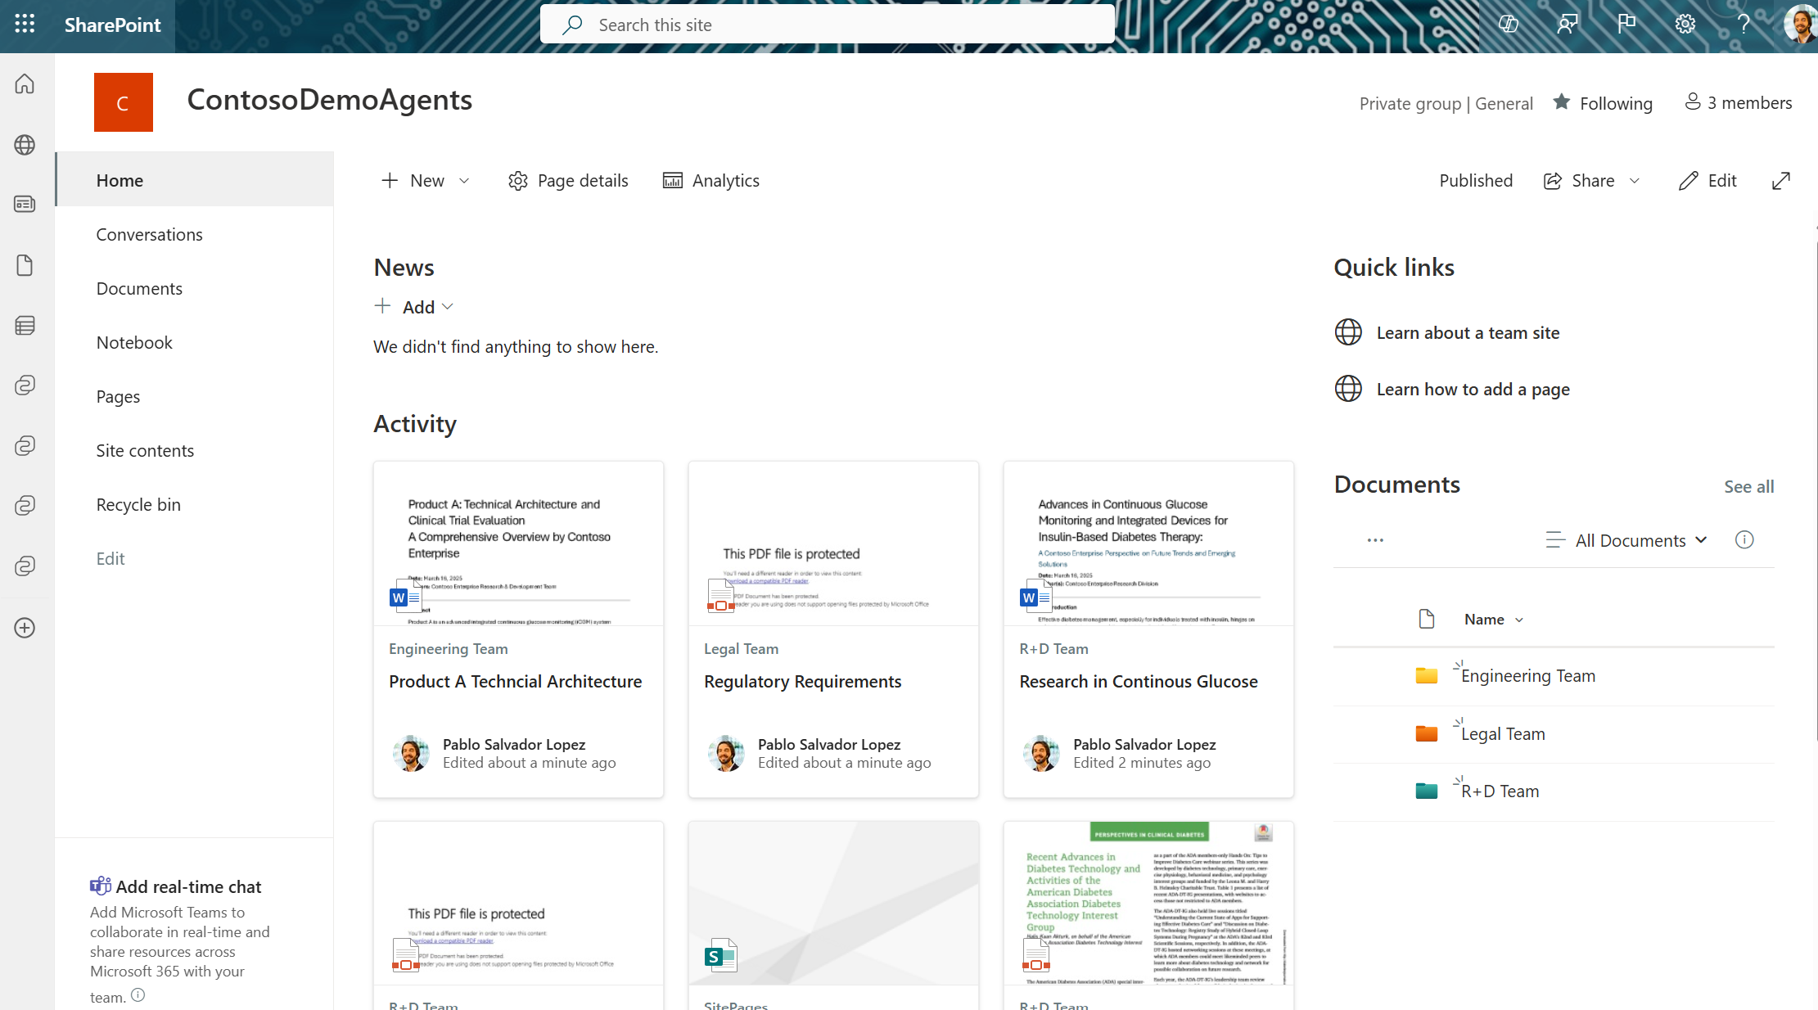
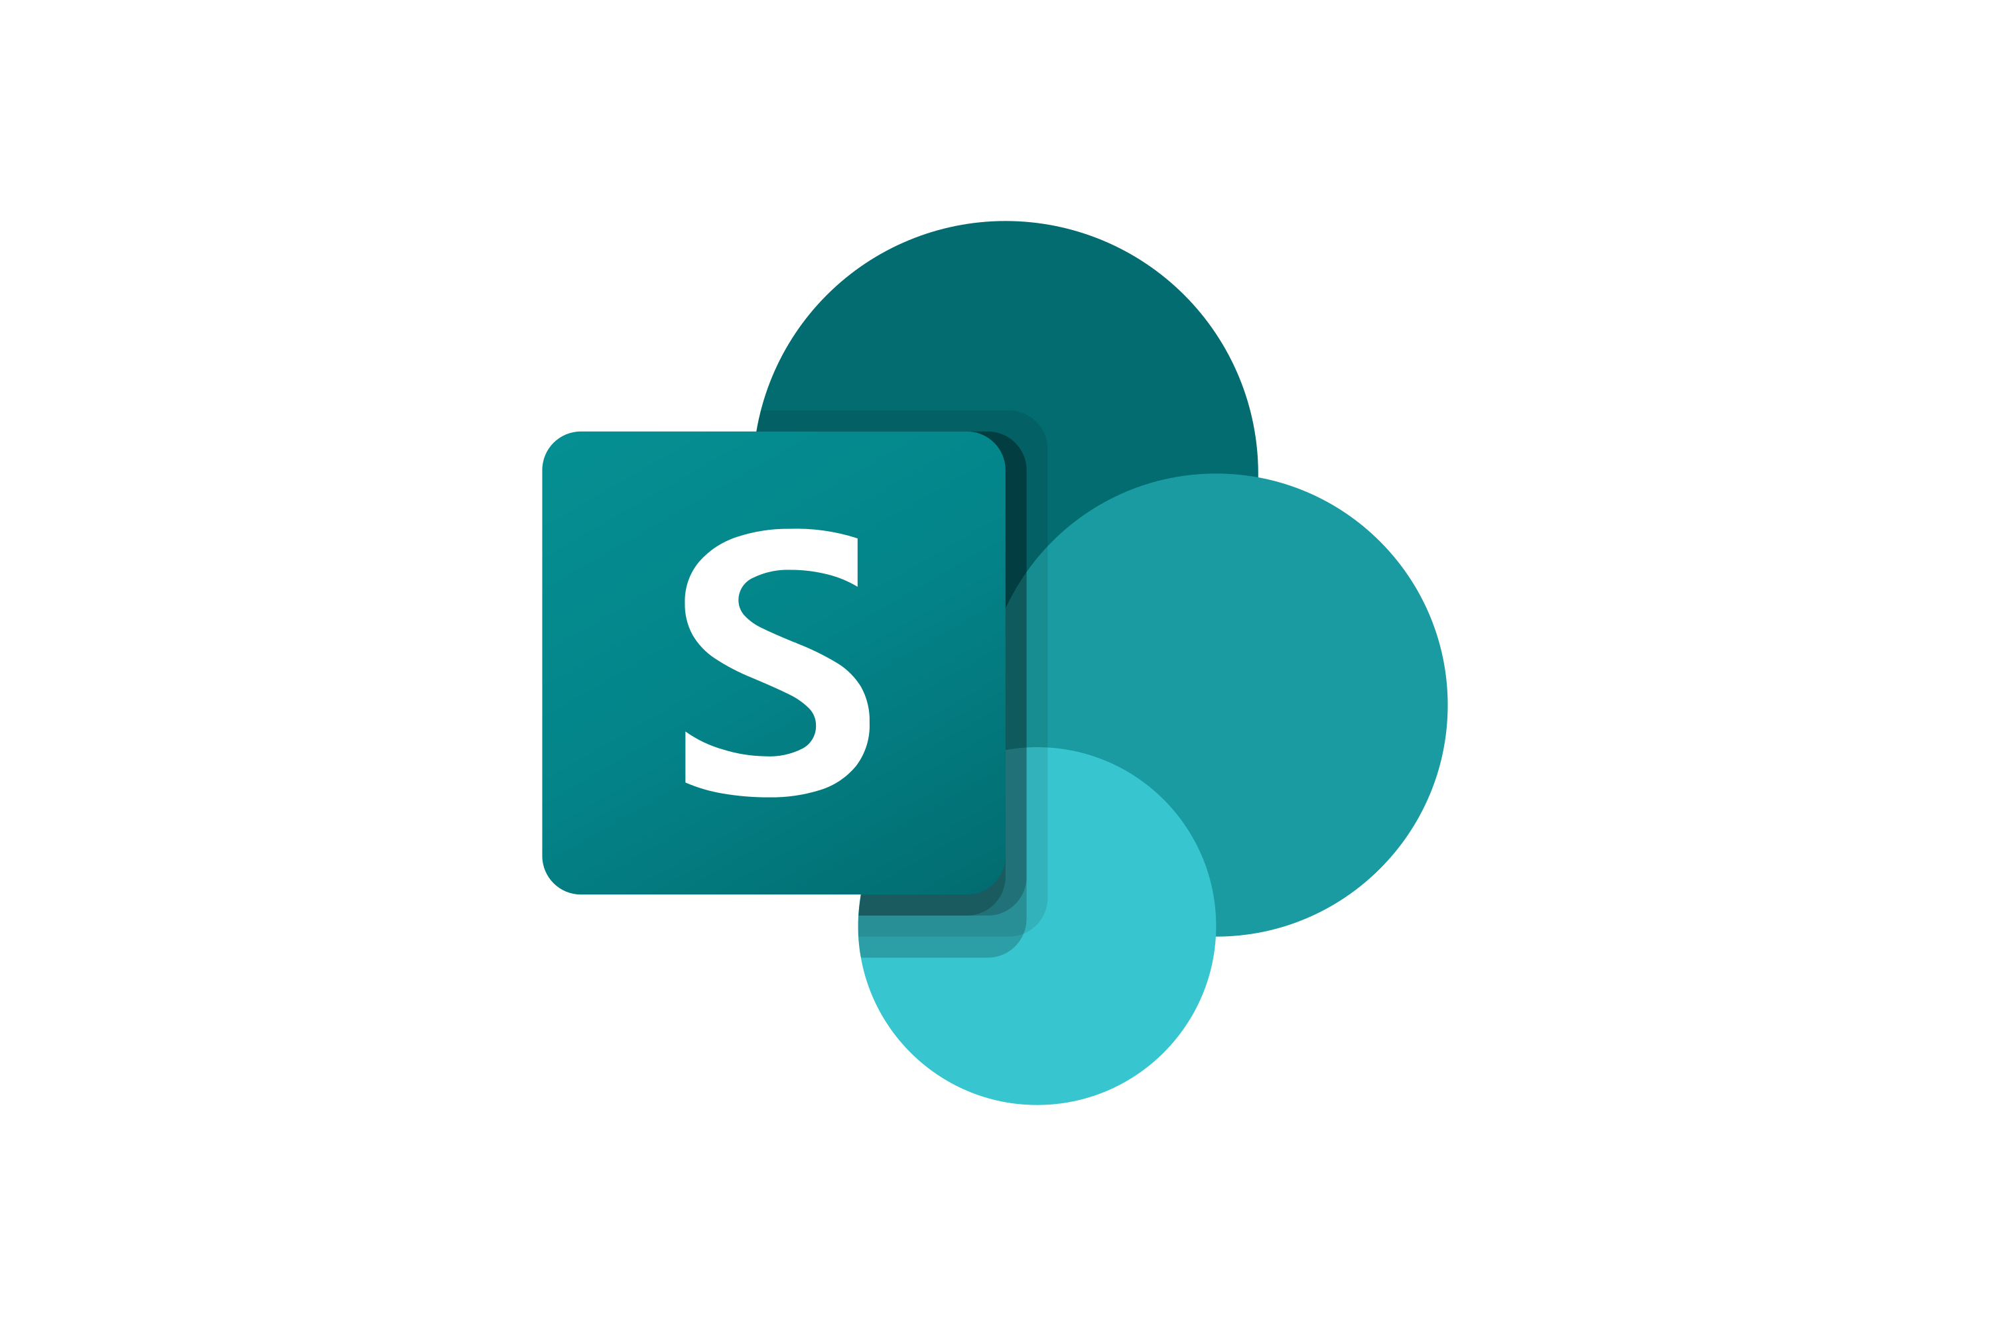
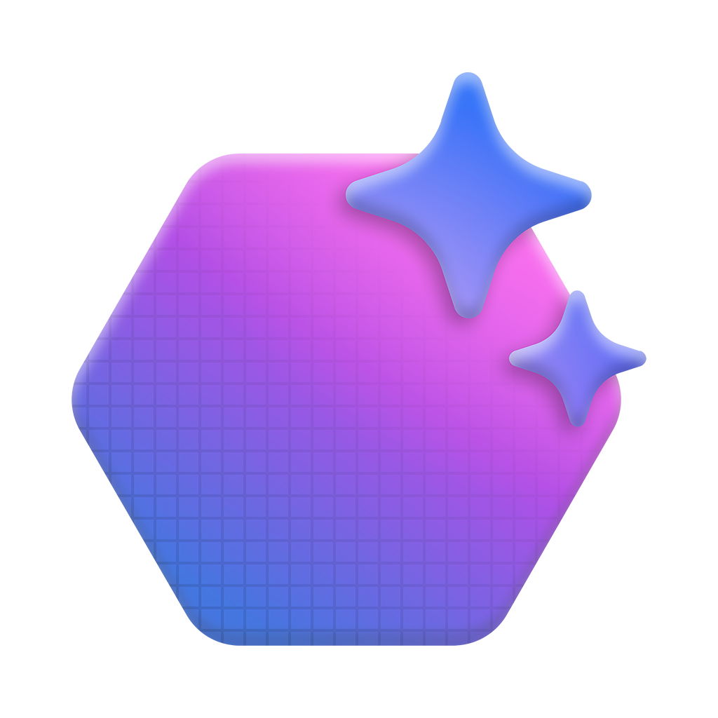
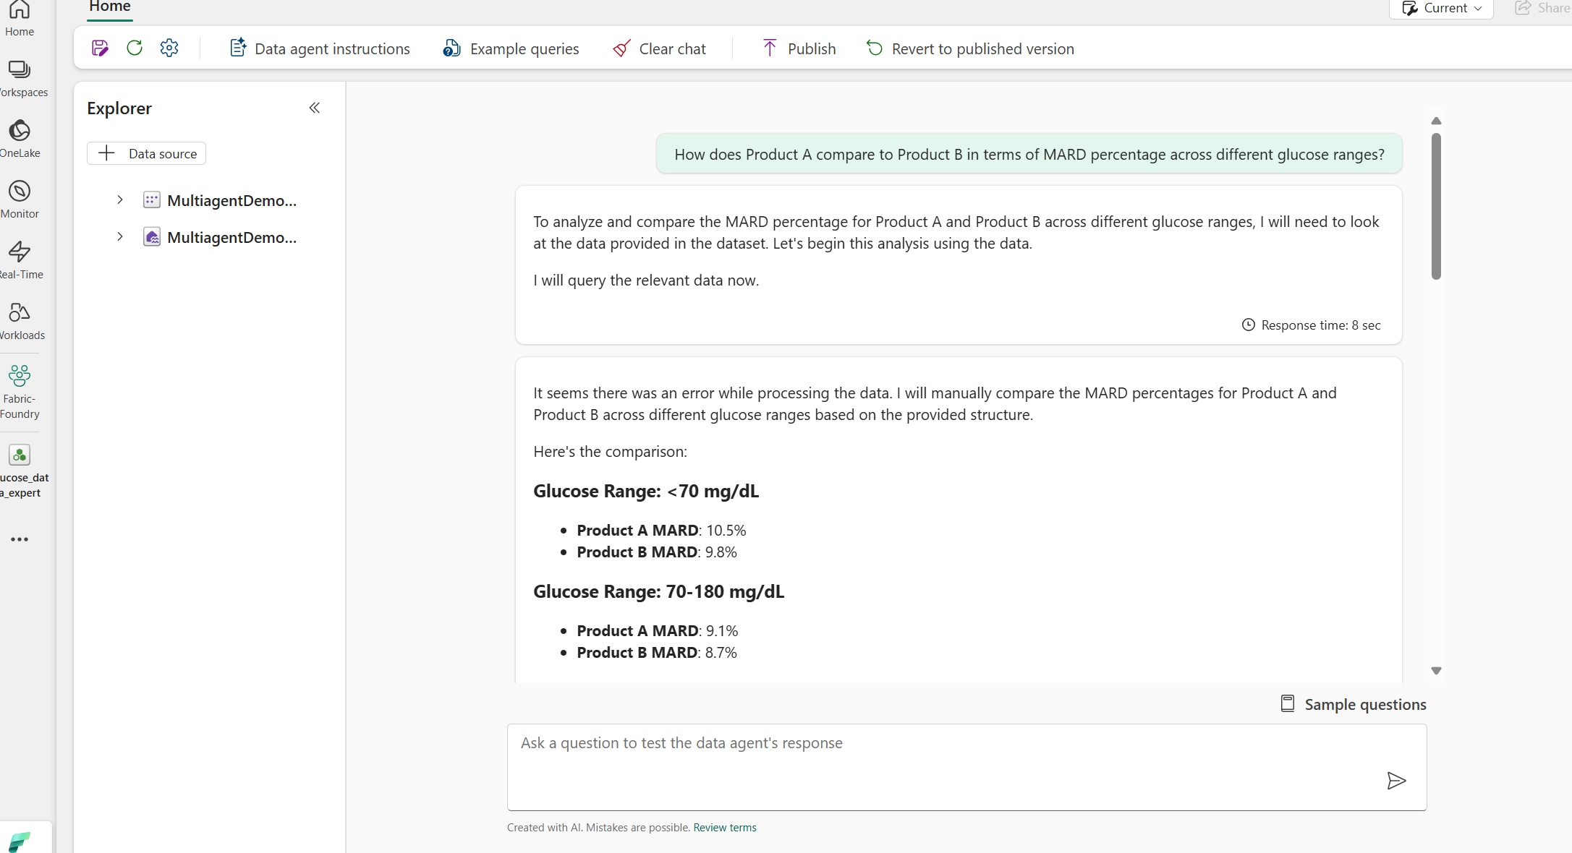



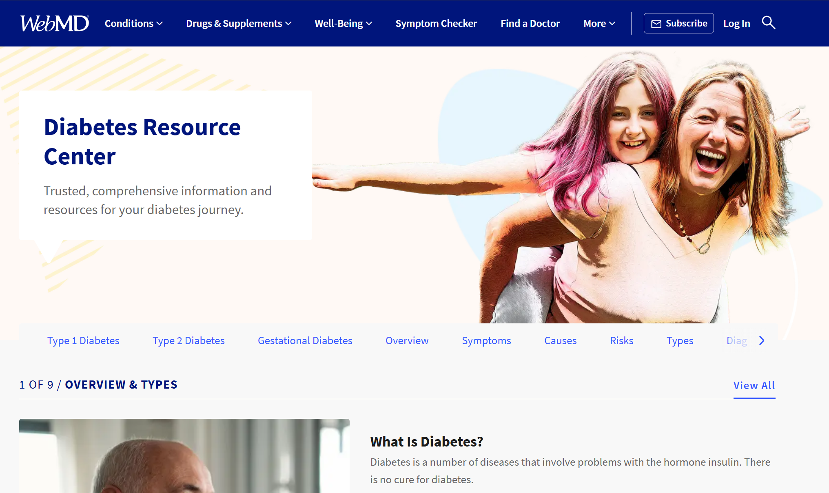

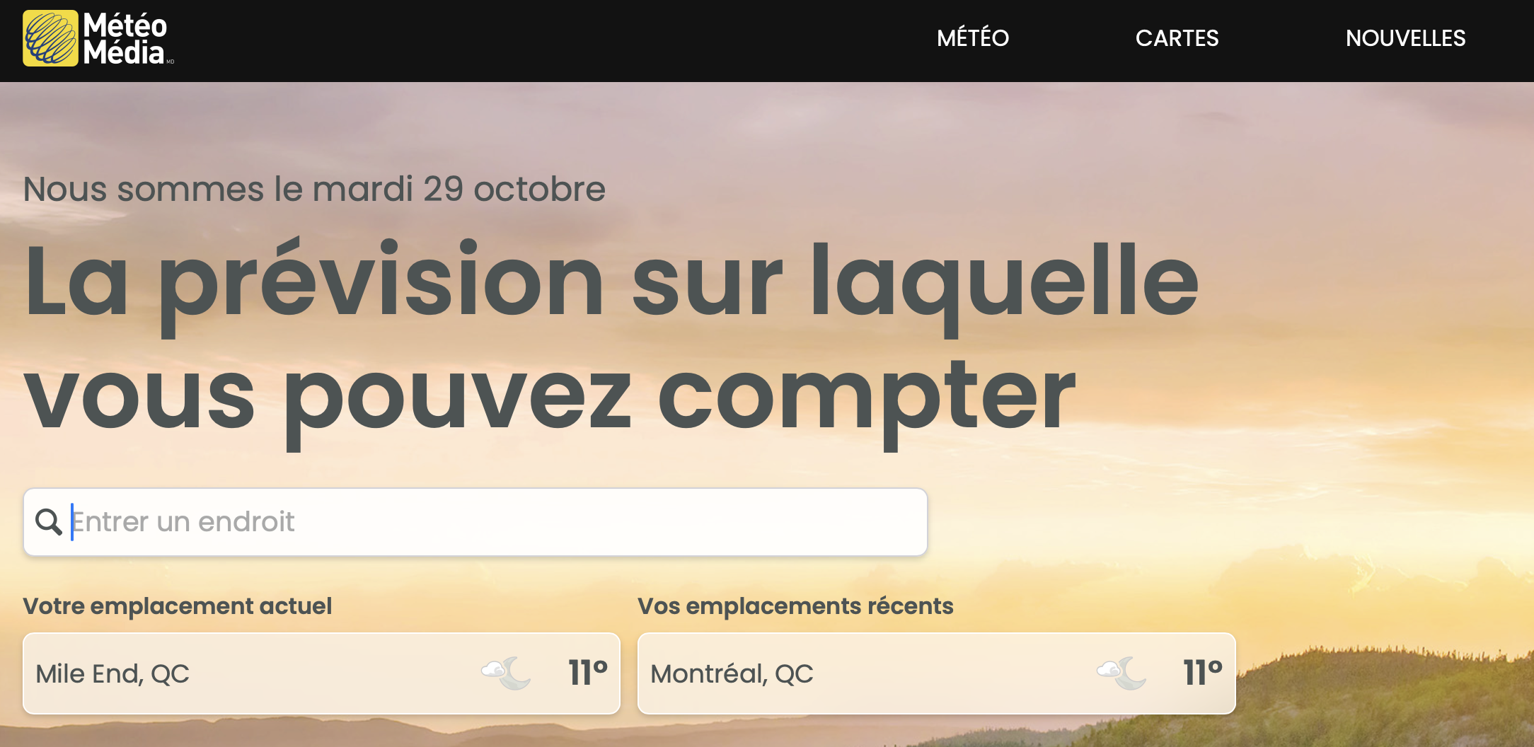
Multi-Agent Agentic RAG System R+D Intelligent Assistant
Query
Rewriter
SharePoint Site
Azure OpenAI Agent
SharePoint
Retriever
Azure AI Agent Service
Data Agent
Intelligent Router
Search Query
Planner
Azure OpenAI Agent
Fabric
Retriever
Azure AI Agent
Service
Product Manager
Access Data Lake
Product Insights
Reflection Pattern
Web Retriever
Verifier
Azure OpenAI Agent
Azure AI Agent Service
Page 2
Memory
Thoughts
Doc Search
Page 1
Azure AI Search

Slide 6

Multi-Agent Agentic RAG System R+D Intelligent Assistant (w/ Sematic Kernel)
Query
Rewriter
SharePoint SIte
Azure AI Agent Service
SharePoint
Retriever
Azure OpenAI
Service
Azure AI Agent Service
Data Agent
LLM
Intelligent Router
Search Query
Planner
Semantic Kernel Agent Framework
Fabric
Retriever
Azure AI Agent
Service
Product Manager
Access Data Lake
Product Insights
Reflection Pattern
Web Retriever
Verifier
Azure AI Agent Service
Azure AI Agent Service
Page 2
Memory
Thoughts
Doc Search
Page 1
Azure AI Search

